Slide 1
E-Safety
Notes:
Sign everyone in and get them to write their first name onto stick label

Slide 2
Aim
To educate young people on how to stay safe on the internet
Keep young people up to date with new trends such as scams/phishing/ safety tips
Signpost young people to the correct help and advice available
Notes:
Roles and responsibilities

Slide 3
Students are highest risk group
Students are almost twice as confident online as other internet users but they are the most dismissive of basic internet safety e.g. anti virus
This complacency translates to their online behaviour, too – students are amongst the greatest culprits in taking unnecessary risks online
28% admit to entering personal details into a website from an unsecured computer, over double the national average of 11%
Almost one in five (19%) regularly post valuable personal information (such as their date of birth or home address) on social networking sites, almost double the national average (11%)

Slide 4
CEOP is a law enforcement agency and is here to help keep children and young people safe from sexual abuse and grooming online. We help thousands of children and young people every year.

Slide 6
Making a Report

Slide 8
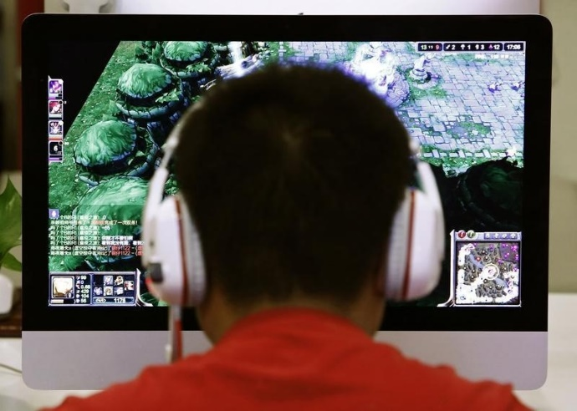
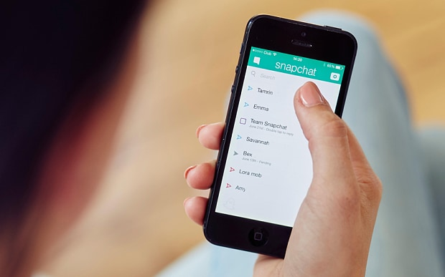
Common online issues relating to young people …
Pornography
Sexting
Gambling
Gaming
Cyber Bullying
Notes:
Ask student to shout out some topics that they think relate to young people, e.g. Sexting. Discuss.

Slide 9
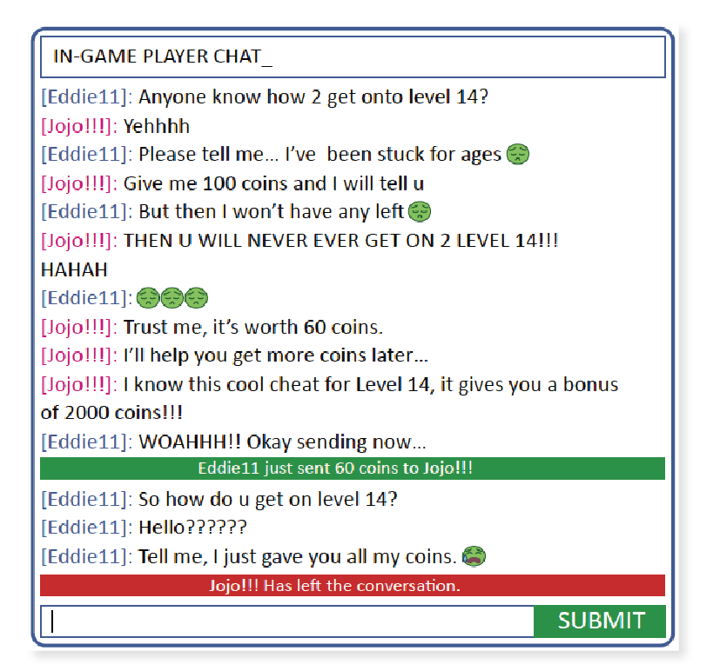
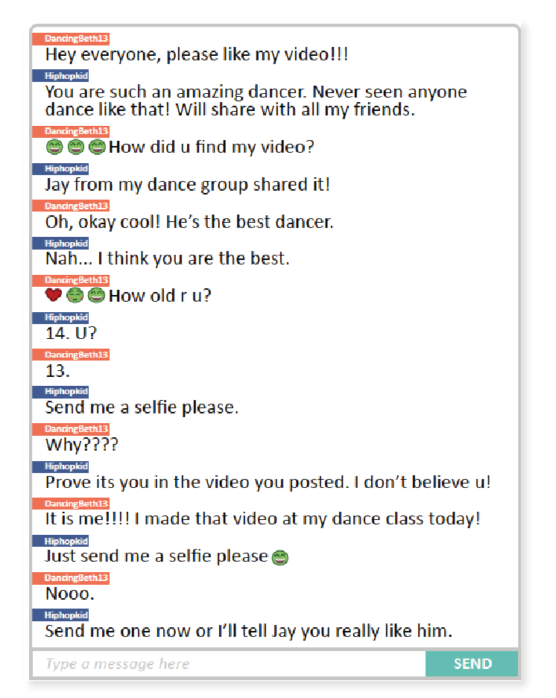
Bribery – red
Flattery – blue
Threats – yellow
Too good to be true offers - green

Slide 10
What is worrying about the conversation?
What strategies is the offender using?
How do you think the young person is feeling? How does this change?
What steps would you take if a young person reported this to you?

Slide 11
Protect Yourself….
USE the privacy settings available
REPORT ANY ABUSE using the button or tell someone
DO NOT post personal information or photographs on the internet.
NEVER arrange to meet someone that you have met via the internet.
Notes:
Ask student to shout out some topics that they think relate to young people, e.g. Block it, Report it etc.

Slide 12
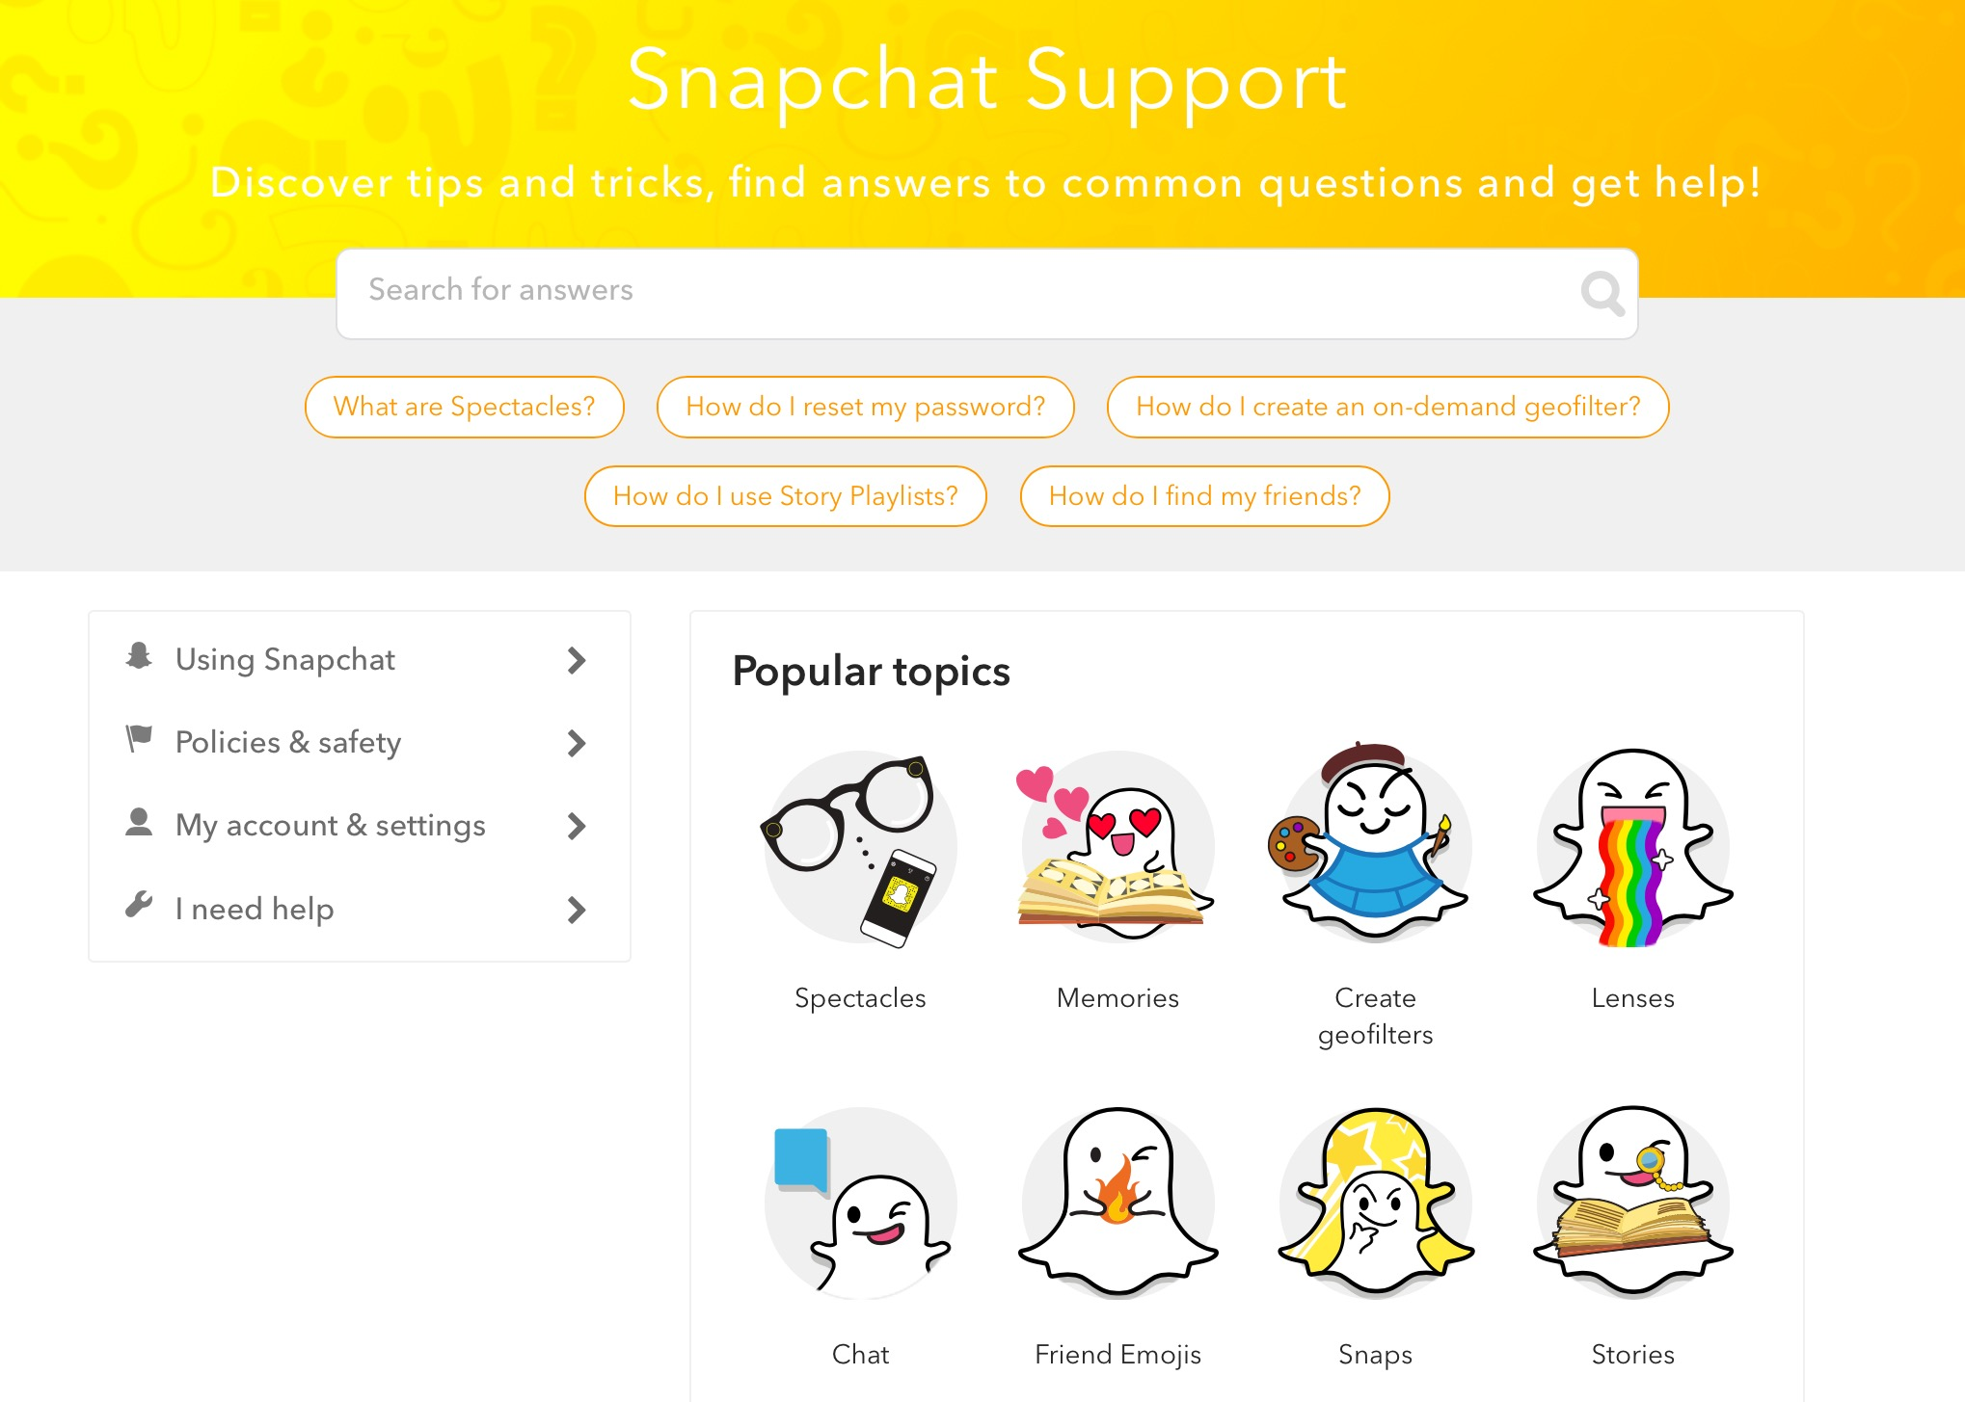
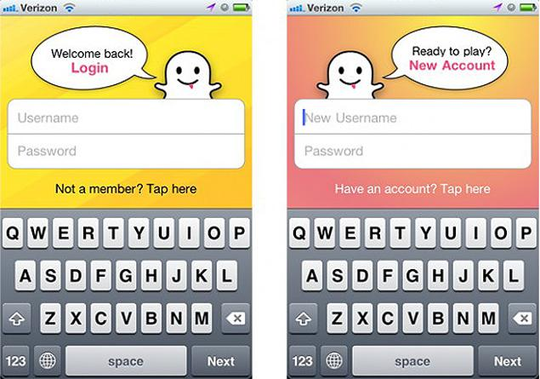
SNAPCHAT

Slide 13
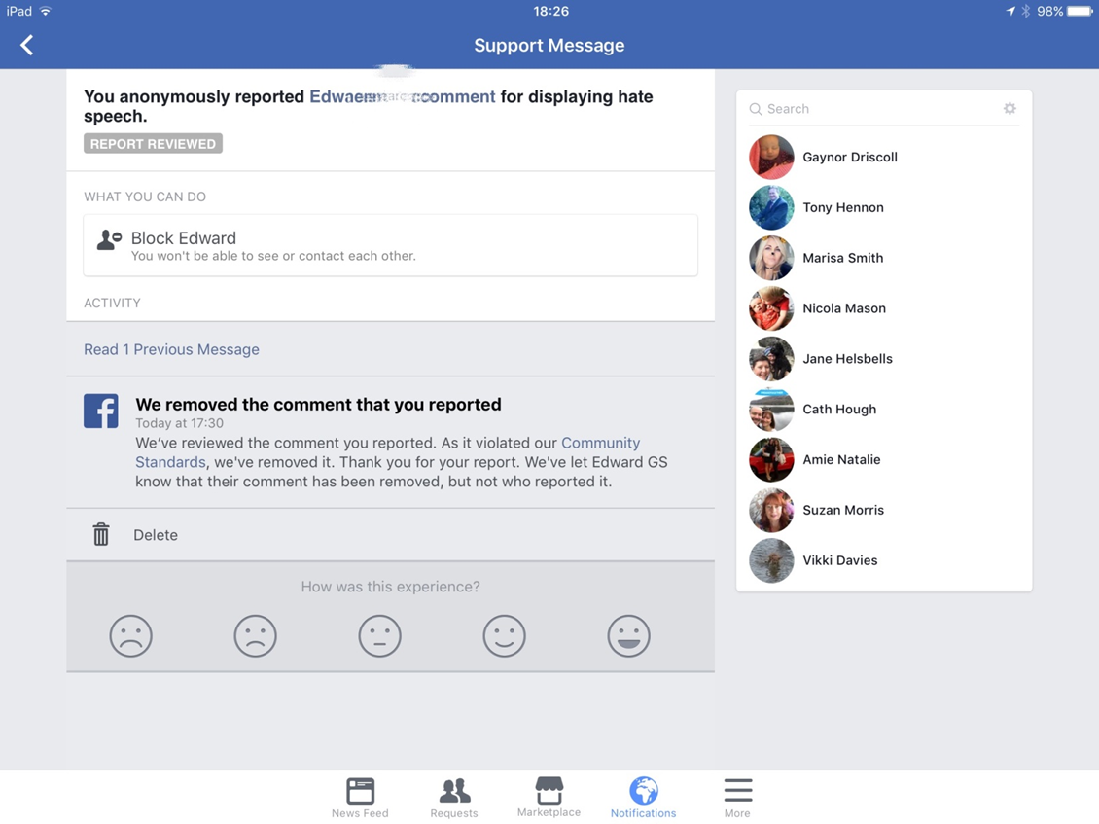

Slide 14
Passwords…
Have a different password for each account (shopping, email, banking, work), so that if one password is compromised, a criminal is less likely to be able to access more than one of your accounts.
What are the best ways of making good strong passwords.
Passwords are like underpants......Keep them private and never share them with others
Notes:
Get the students to shout out 3 random words = write on flipchart to explain the formula F$n0wCo1dh4tk8 etc.

Slide 15
List the different reasons why a young person might share a nude selfie.

Slide 19
Any Questions?

